Slide 1
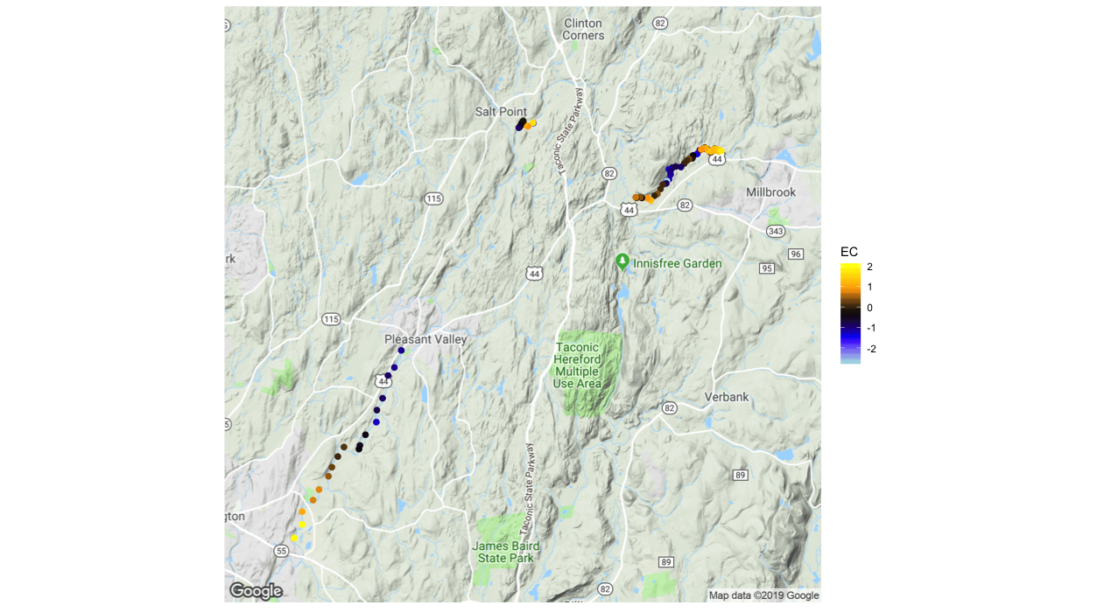
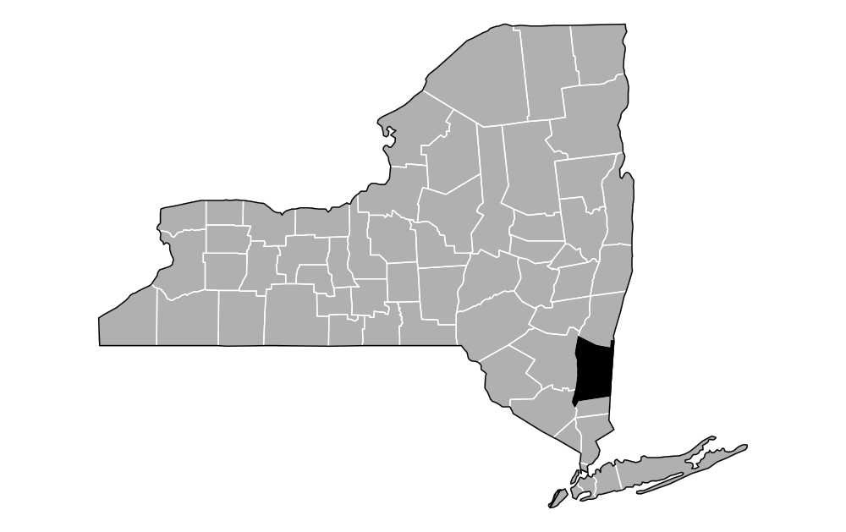
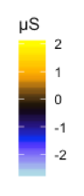
Site One
Site Three
Reach Normalized Specific Conductance (μS/cm)
High Angle
Fault Zone
Site Two
1.0
2.0 Km

Slide 2
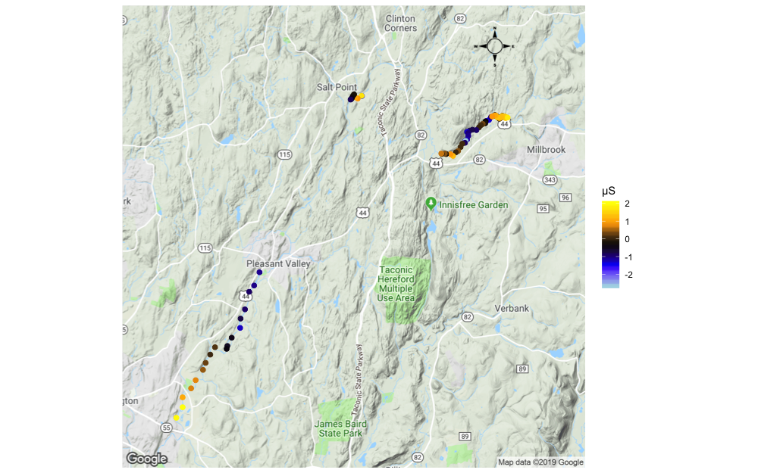
= High Angle
Fault Zone

